Slide 1
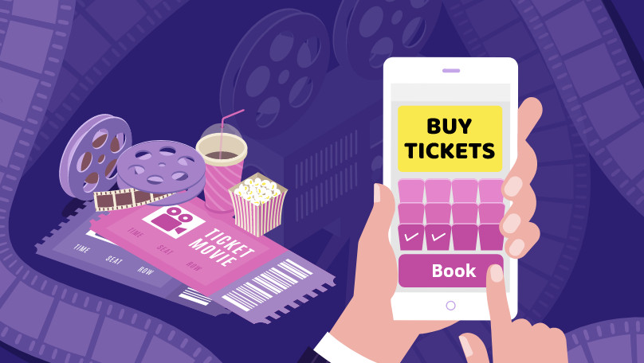
ONLINE MOVIE TICKET BOOKING APPLICATION

Slide 2
PRESENTED BY:
Pattem Jaya Lakshmi
Suma Bhimarao Shindhe
Vetri Sairam BK
Vishwajeet Thakur
Vignesh K
Nilesh Dharmraj Yadav
Swati Navnath Shingate
Darukumalli Krishna Chaitanya
Saranya C
Rachana A H
Hemanth Kumar Koppa

Slide 3
CONTENTS:
SCOPE
INTRODUCTION
SYSTEM OVERVIEW
MODULES
OVERVIEW OF PROJECT
FUTURE ENHANCEMENTS
CONCLUSION

Slide 4
SCOPE OF PROJECT
Aim of the project: The aim of this project is to develop an Online Movie Ticket Booking application.
The Online Ticket Booking System is an internet based application that can be accessed through the Net and can be accessed by anyone who has a net connection.
Our Online Ticket Booking System is one of the best opportunities for those who cannot afford enough time to get their tickets reserved standing in long queues.

Slide 5
INTRODUCTION
Online Movie Ticket Booking application is basically made for providing the customer an anytime and anywhere service for booking the seat in the cinema hall.
This system reduces or in some cases eliminates the hardship faced by existing offline system.
Technologies used: Spring Boot, Hibernate, Angular.

Slide 6
SYSTEM OVERVIEW
The “Online Movie Ticket Booking System “ will support basic functionalities for below users.
Administrator
Customer

Slide 7
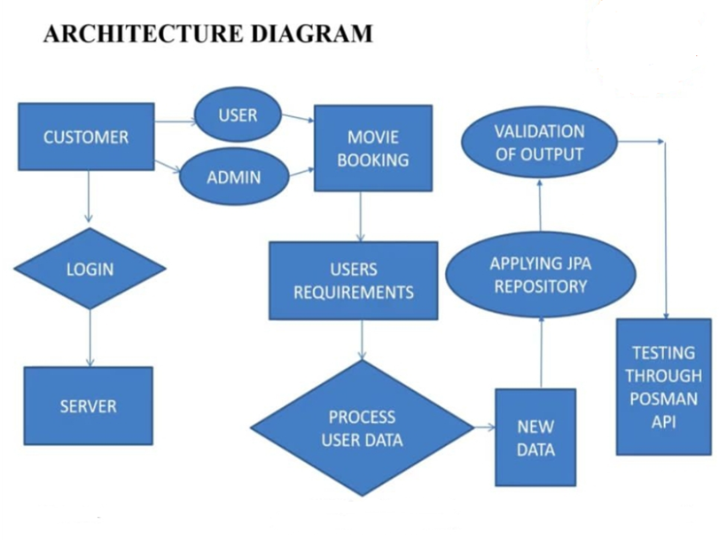

Slide 8
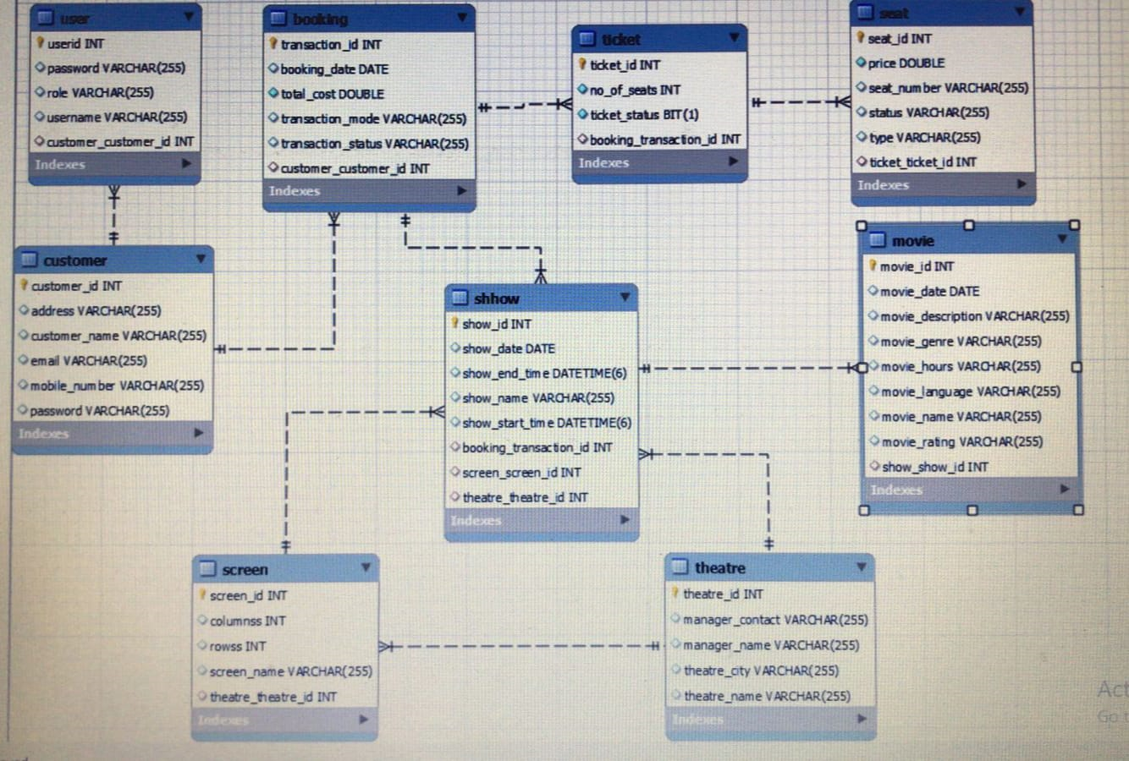
ER DIAGRAM

Slide 9
MODULES
USER MODULE
Fields Required : Userid
Password
Role
Username
Customer_Id
Rest API’s Performed: Adduser
Removeusers

Slide 10
CUSTOMER MODULE
Fields Required : Customer_id
Address
Customer_name
Email
Mobile_number
Password
Rest API’s Performed: Update
Delete

Slide 11
ADMIN MODULE
Fields Required : Username
Password
Rest API’s Performed: Add

Slide 12
LOGIN MODULE
Fields Required : Username
Password
Rest API’s Performed: Add
Remove

Slide 13
MOVIE MODULE
Fields Required : Movie_id
Movie_date
Movie_description
Movie_genre
Movie_hours
Movie_language
Movie_name
Movie_rating
Movie_show_id
Rest API’s Performed : Movie/add
Movie/map
Movie/findall
Movie/rename
Viewmovie/movieid

Slide 14
THEATRE MODULE
Fields Required : Theatreid
Manager_Contact
Manager_Name
Theatre_Name
Theatre_City
Rest API’s Performed: Show/add
Show/update
Show/remove
Show/all
Showtheatre/theatreid

Slide 15
SCREEN MODULE
Fields Required : Screen_id
Columns
Row
Screen_Name
Theatre_theatre_id
Rest API’s Performed: Add
Update
View
Findall

Slide 16
SHOW MODULE
Fields Required : Show_id
Show_start_time
Show_end_time
Show name
Movie.movie_id
Screen.screen_id
Theatre.theatre_id
Booking.transaction_id
Rest API’s Performed: Add
Update By id
Delete By id
View By id
Find all
Show theatre by theatre id

Slide 17
SEAT MODULE
Fields Required : Seatid
Seat price
Seat number
Seat Status
Seat type
Ticket.ticket_id
Rest API’s Performed: Add
Findall
Update
Book
Cancel

Slide 18
TICKET MODULE
Fields Required : Ticketid
No.of seats
Ticket status
Booking_transaction_id
Rest API’s Performed: Add
Findall/view
View by ticket id

Slide 19
BOOKING MODULE
Fields Required : Transactionid
Booking date
Total cost
Transaction mode
Transaction status
Customer.customer_id
Rest API’s Performed: Add
Delete
View

Slide 20
FUTURE ENHANCEMENT
More features can be added like allowing customer to comment on movies.
Provide a list of upcoming movies and searching facilities based on various factors.
Secure payment module can be added to the application, for money transaction during ticket booking, using various methods like net banking, UPI, with OPT verification.

Slide 21
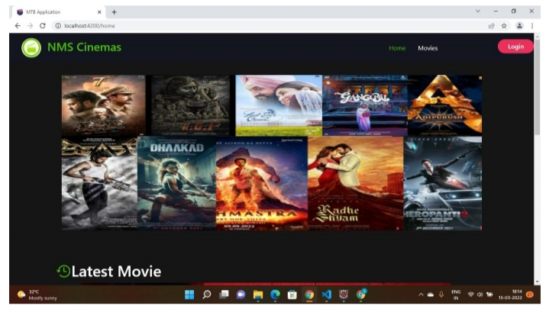

Slide 22
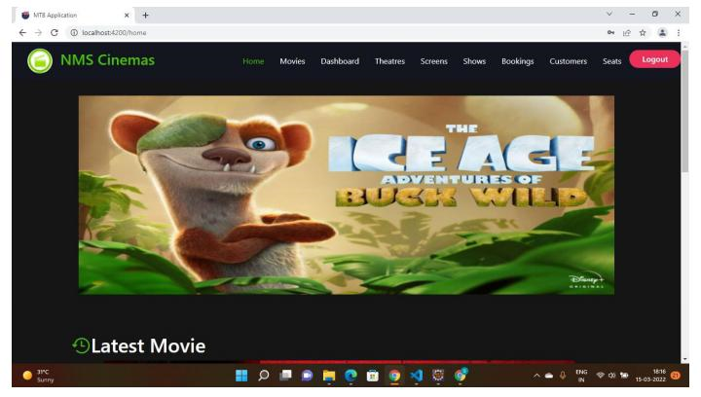

Slide 23
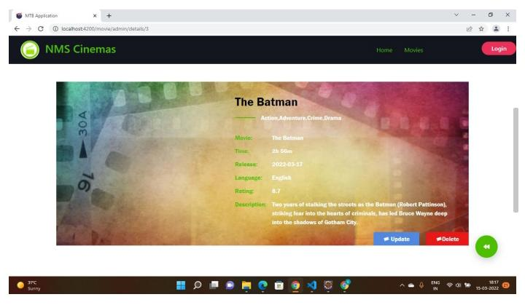

Slide 24
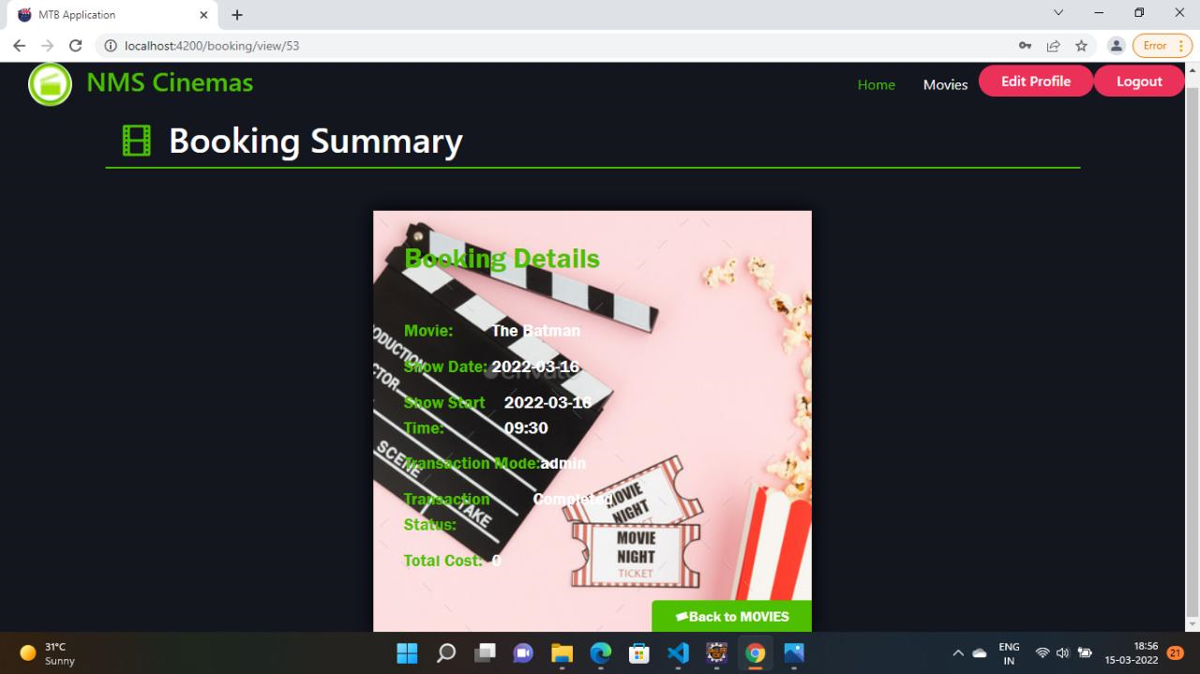

Slide 25
CONCLUSION
This project is designed to meet the requirement of a movie ticket booking application
We have designed the project to provide user with easy retrieval of data necessary feedback as much as possible.
This system has been developed with much care and free of errors and at the same time it is efficient and less time consuming.

Slide 26


